Slide 1
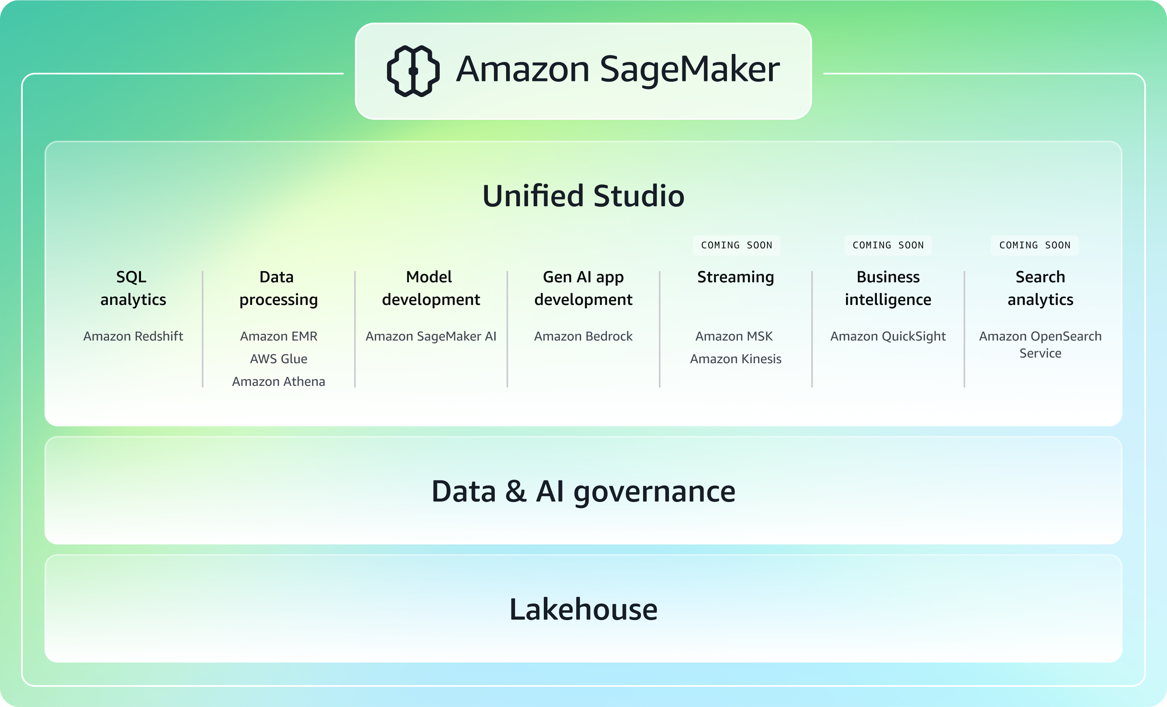
SageMaker Workflow
Sushant – 12218023

Slide 2
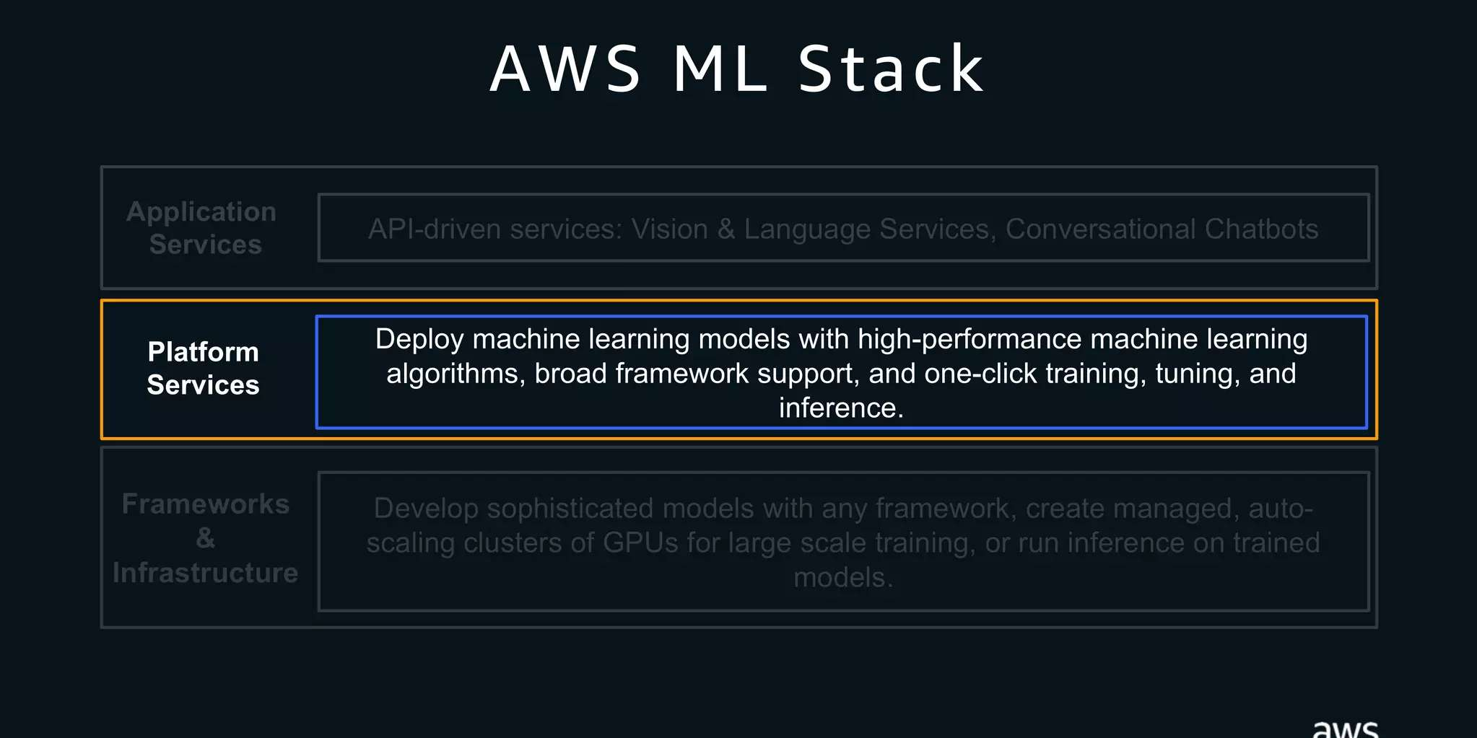
Sushant – 12218023

Slide 3
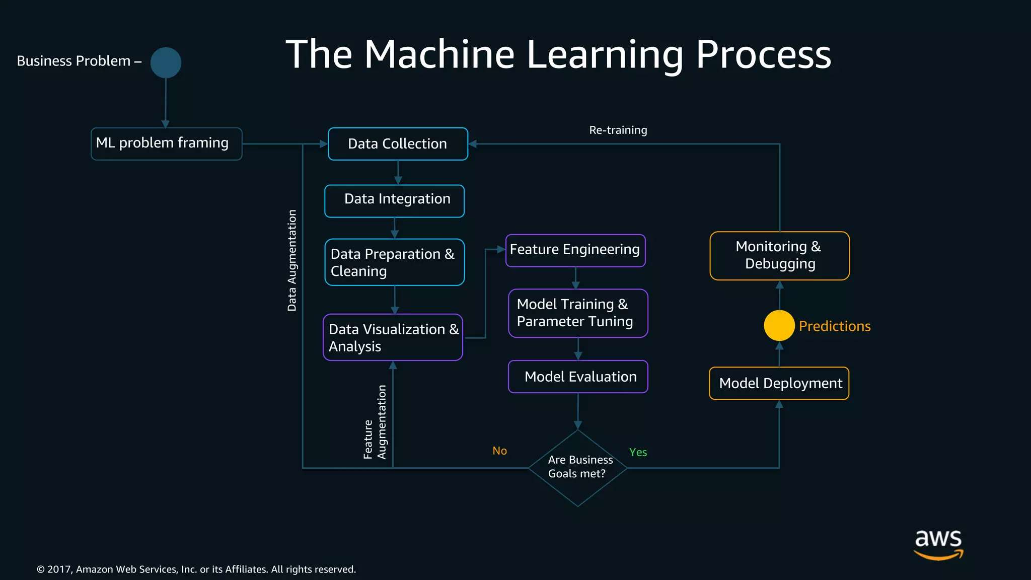
Sushant – 12218023

Slide 4
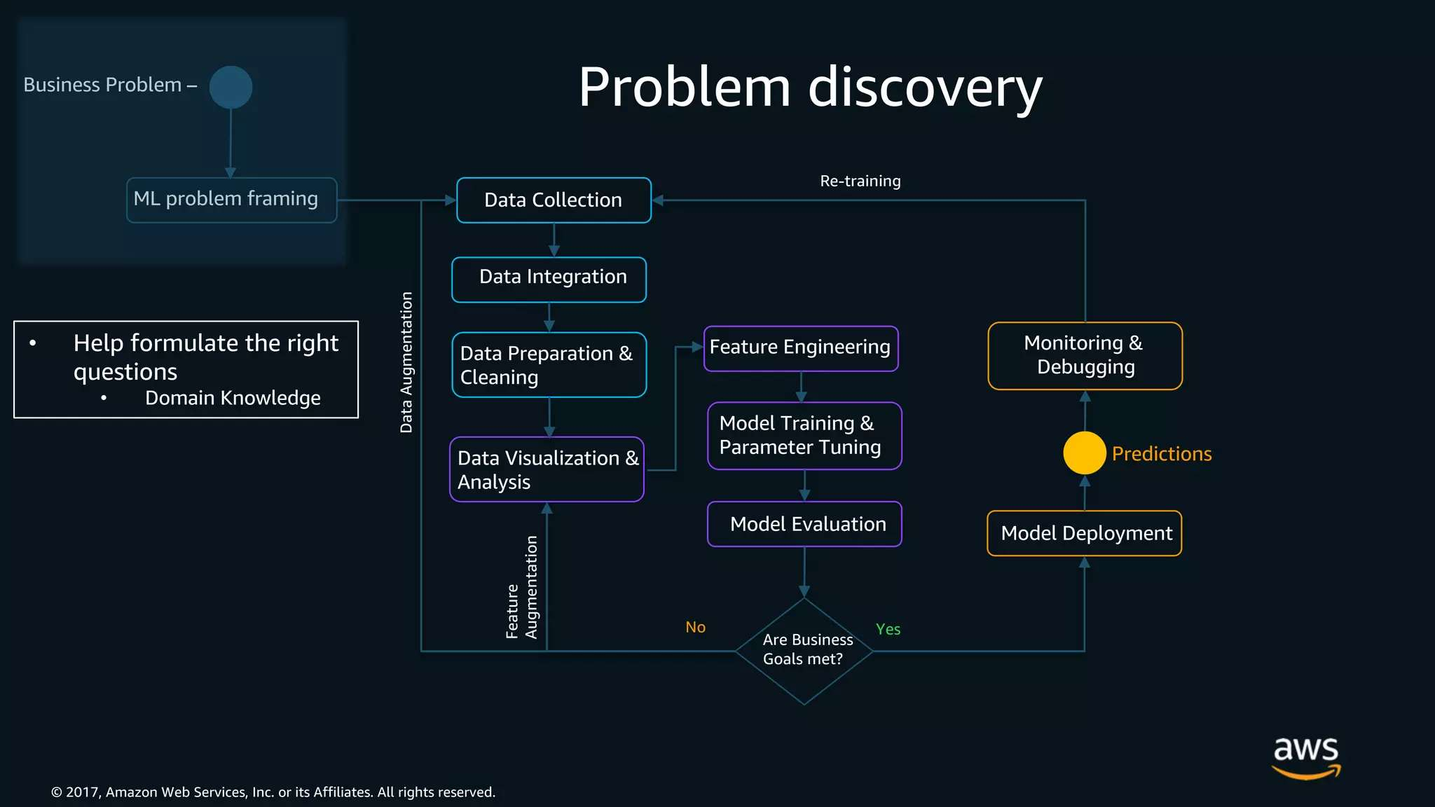
Sushant – 12218023

Slide 5
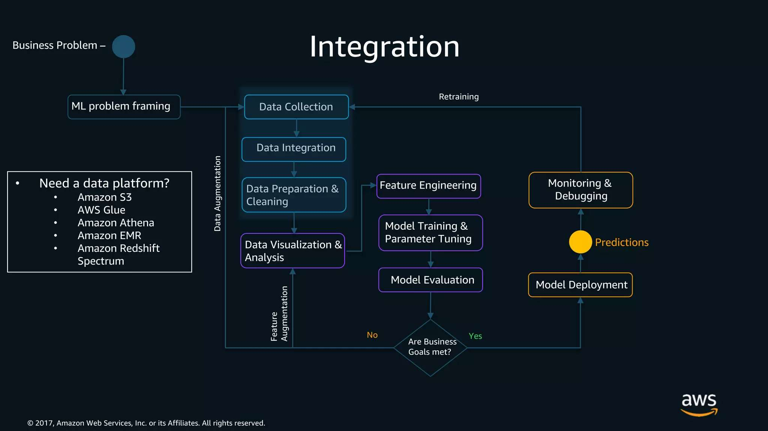
Sushant – 12218023

Slide 6
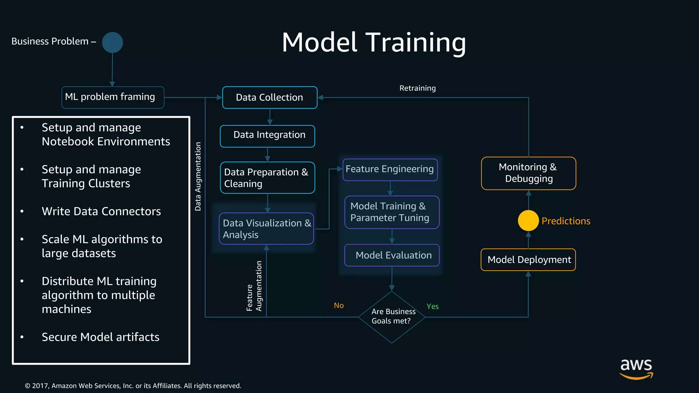
Sushant – 12218023

Slide 7
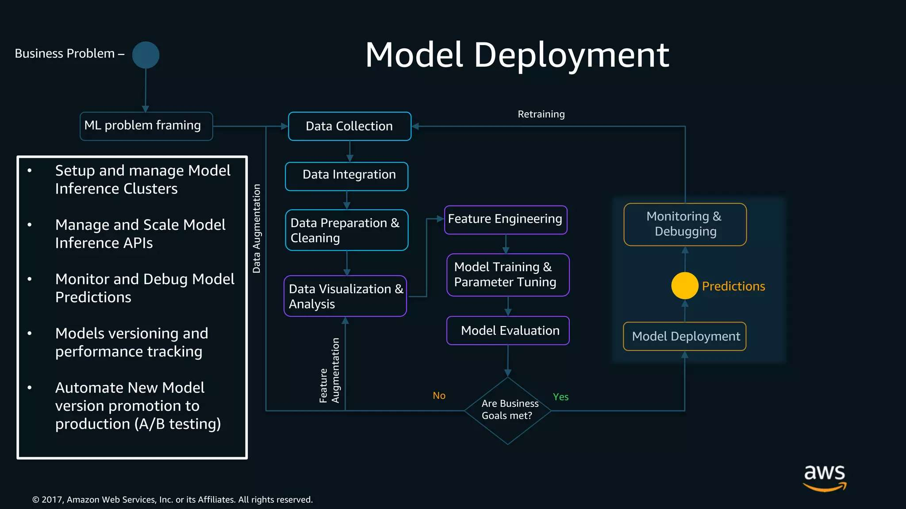
Sushant – 12218023

Slide 8
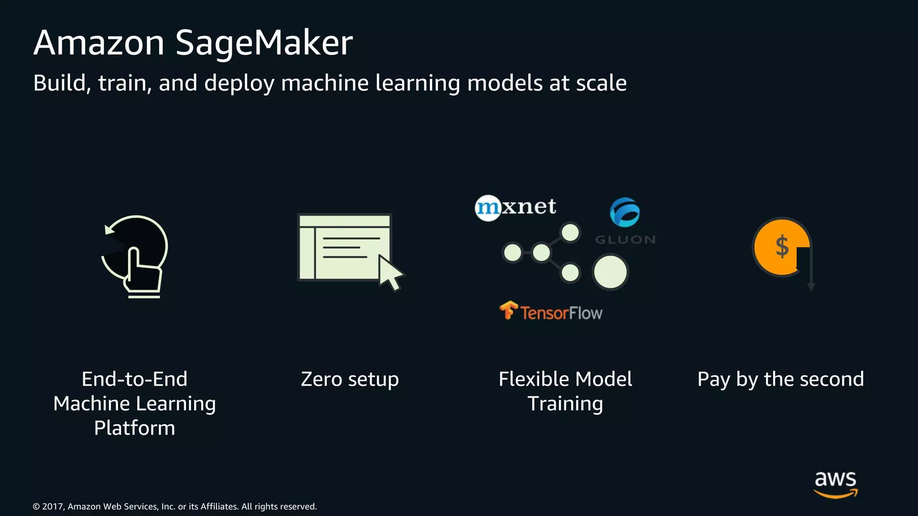
Sushant – 12218023

Slide 9
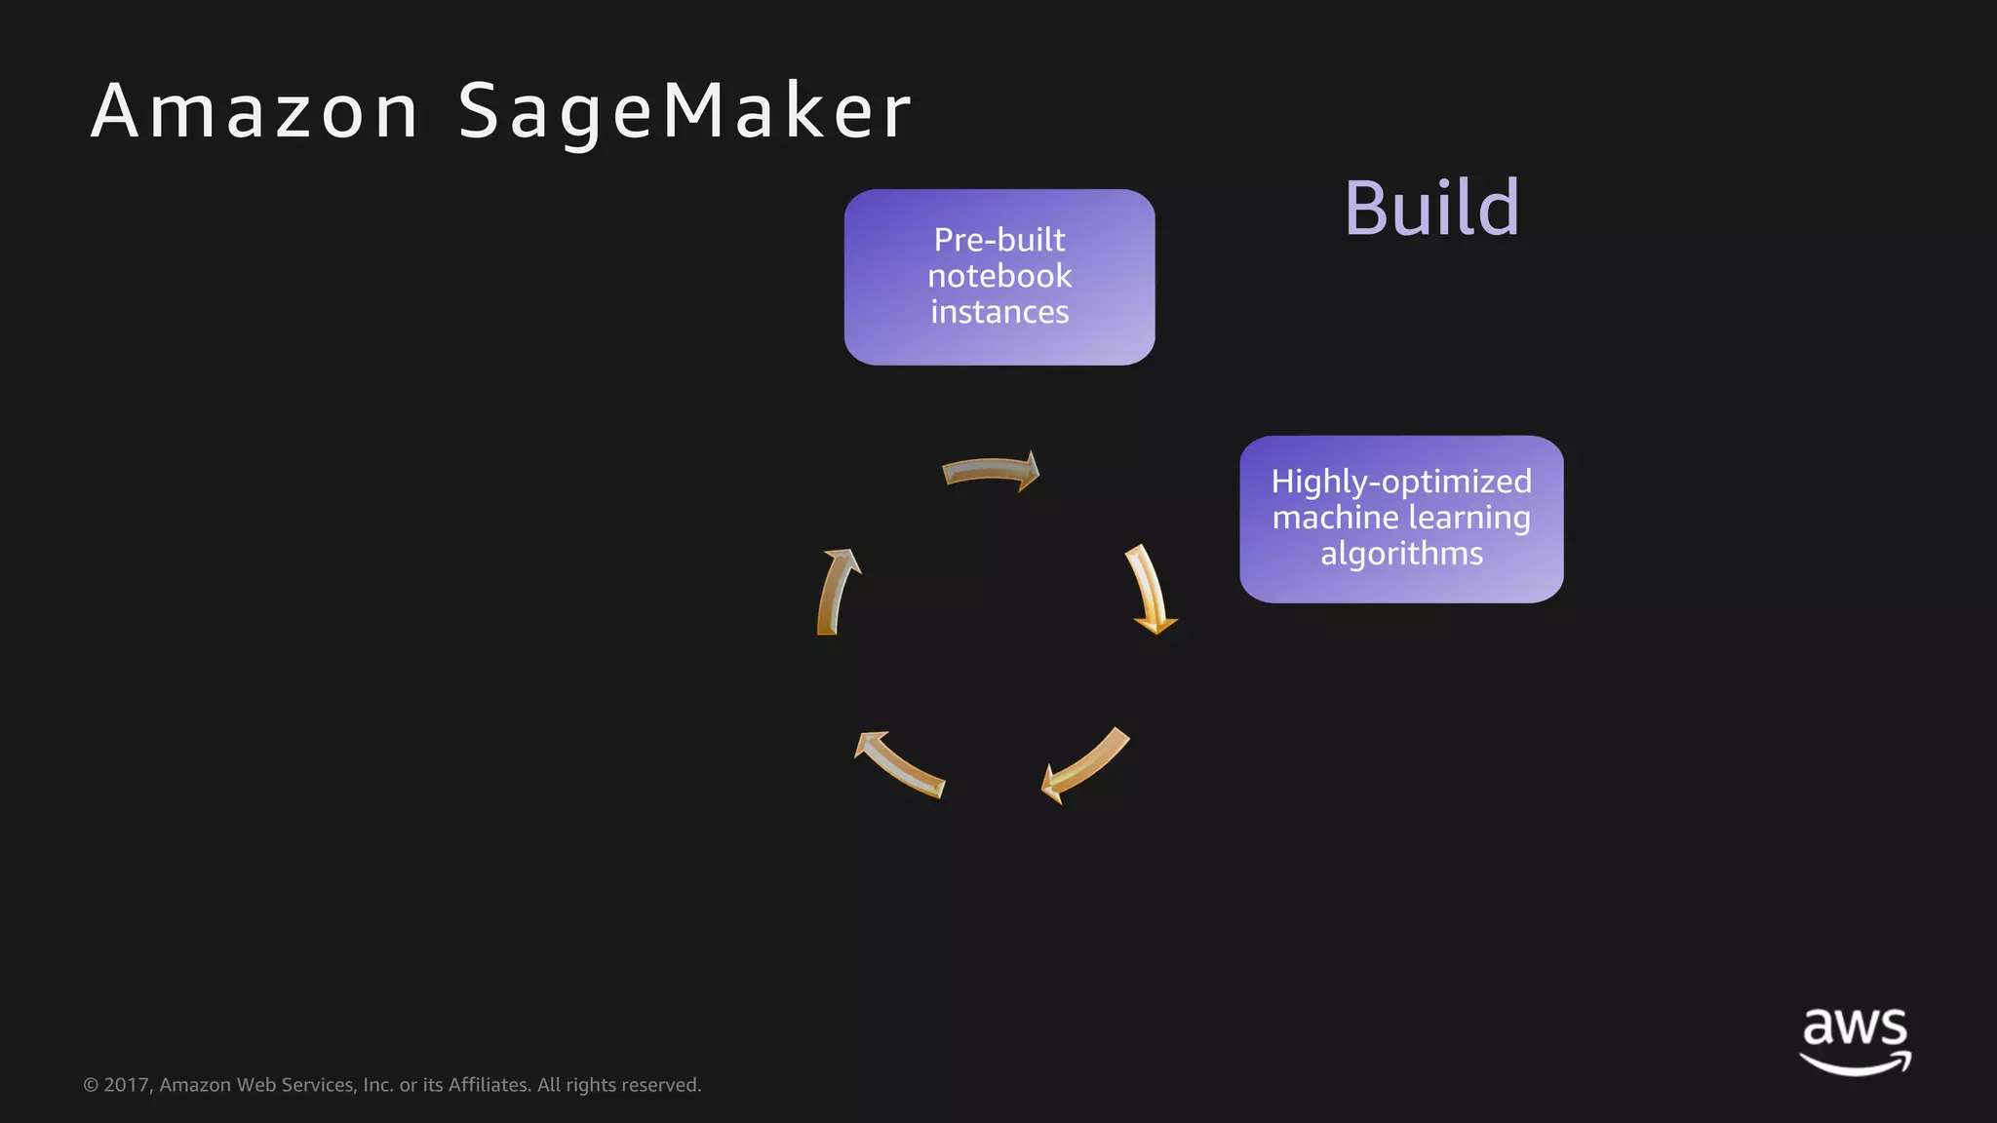
Sushant – 12218023

Slide 10
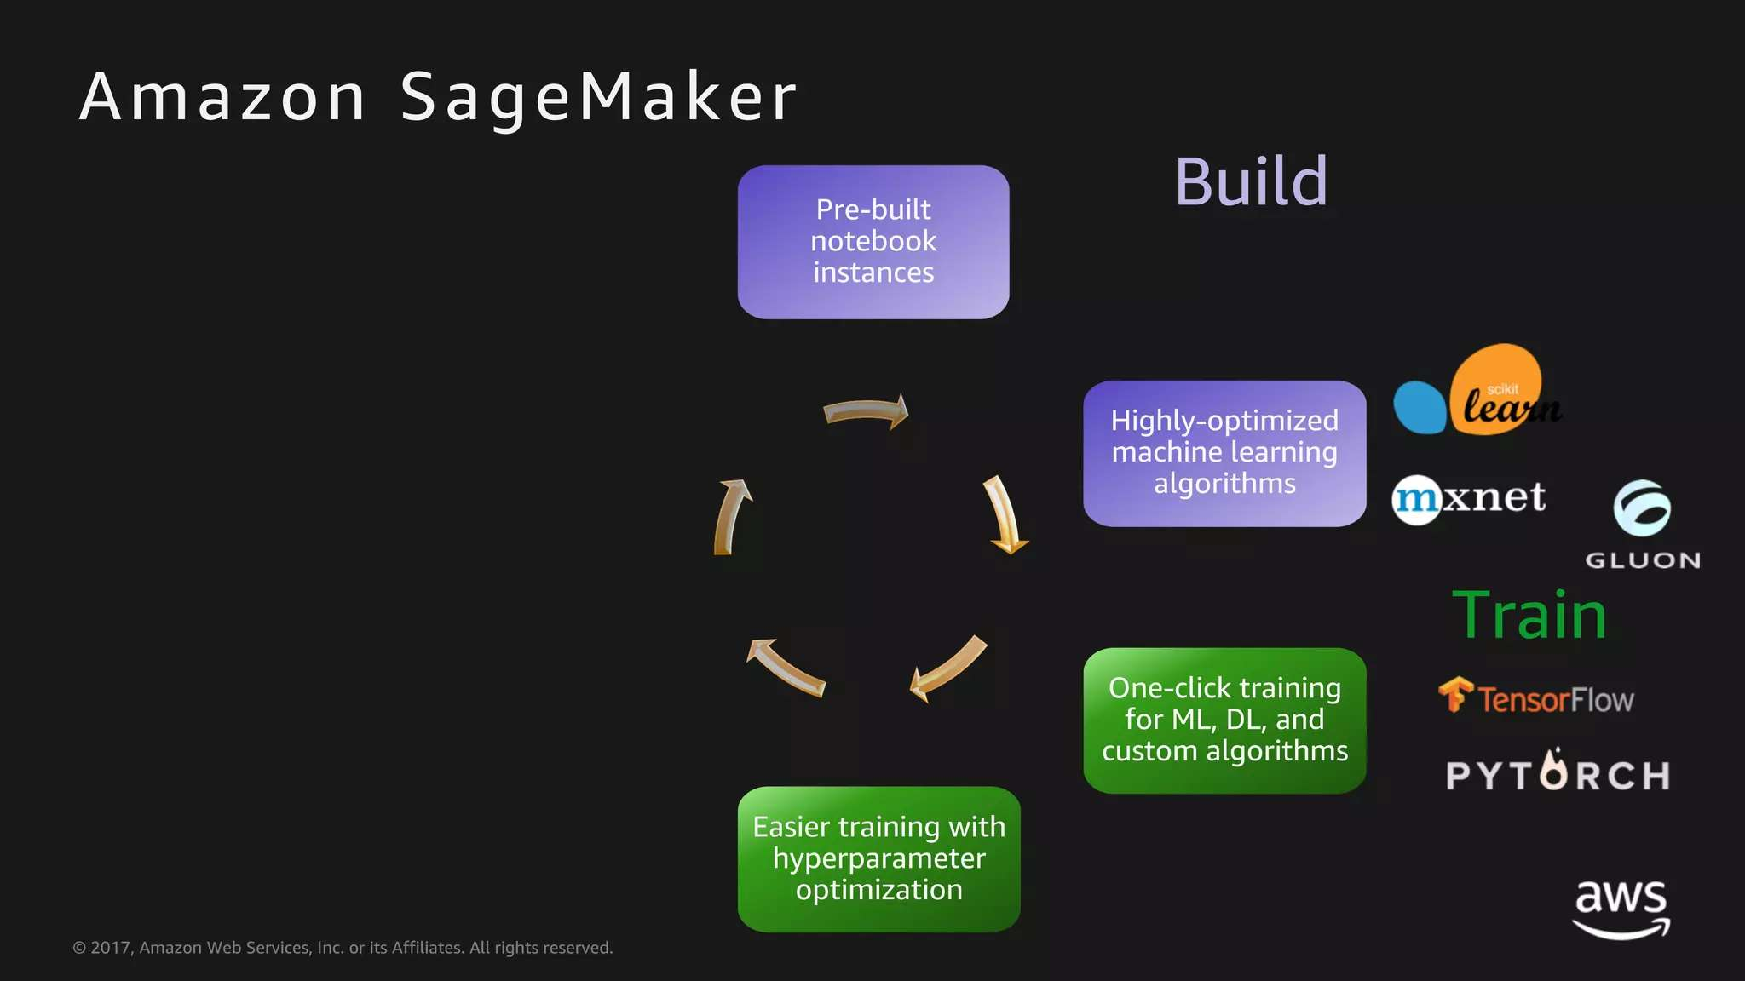
Sushant – 12218023

Slide 11
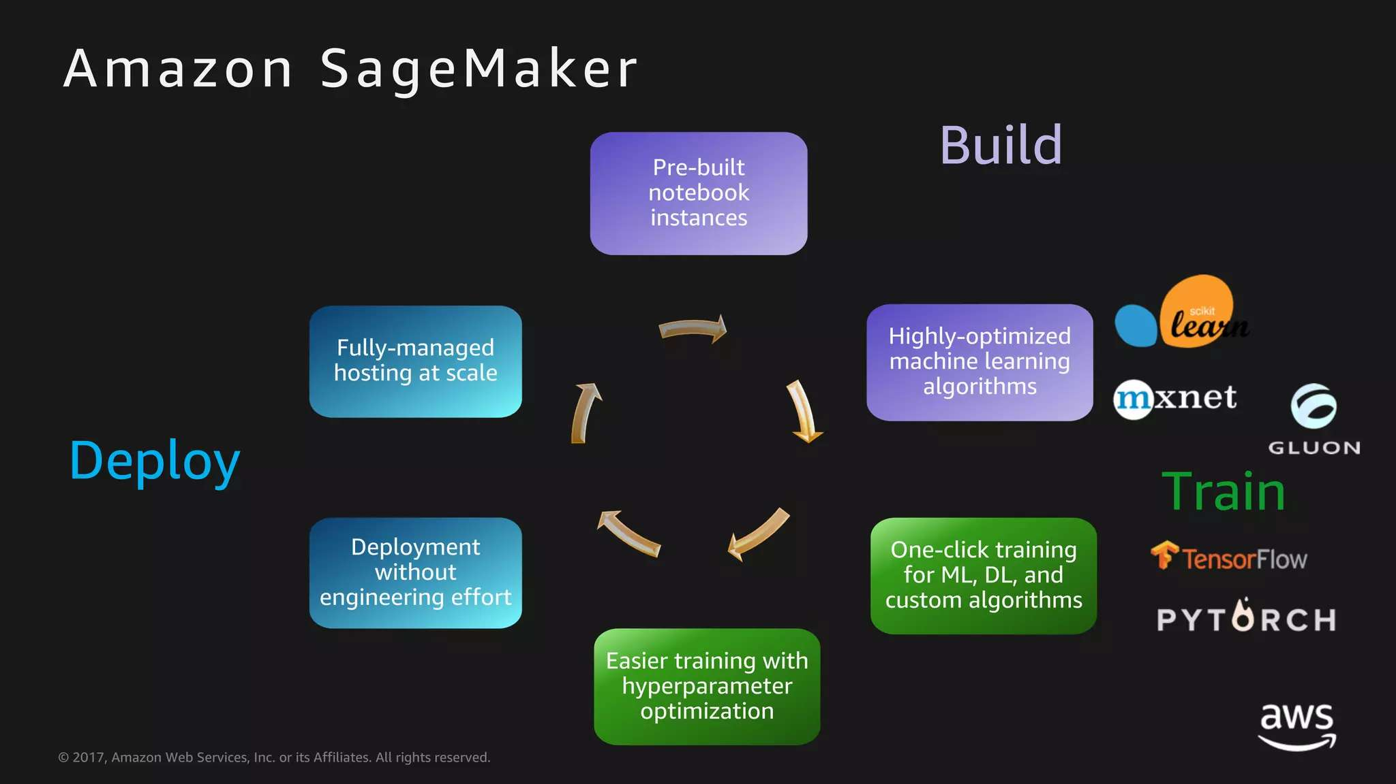
Sushant – 12218023

Slide 12
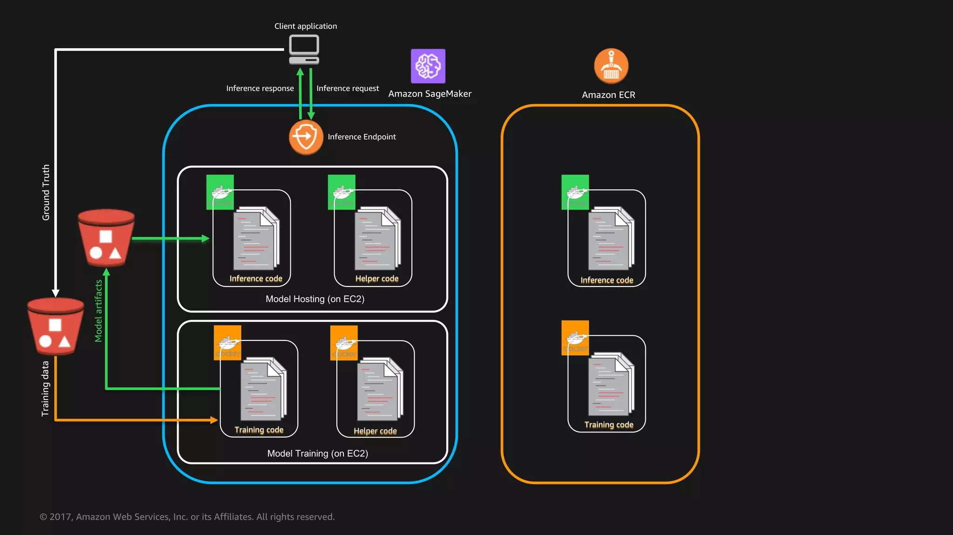
Sushant – 12218023

Slide 13
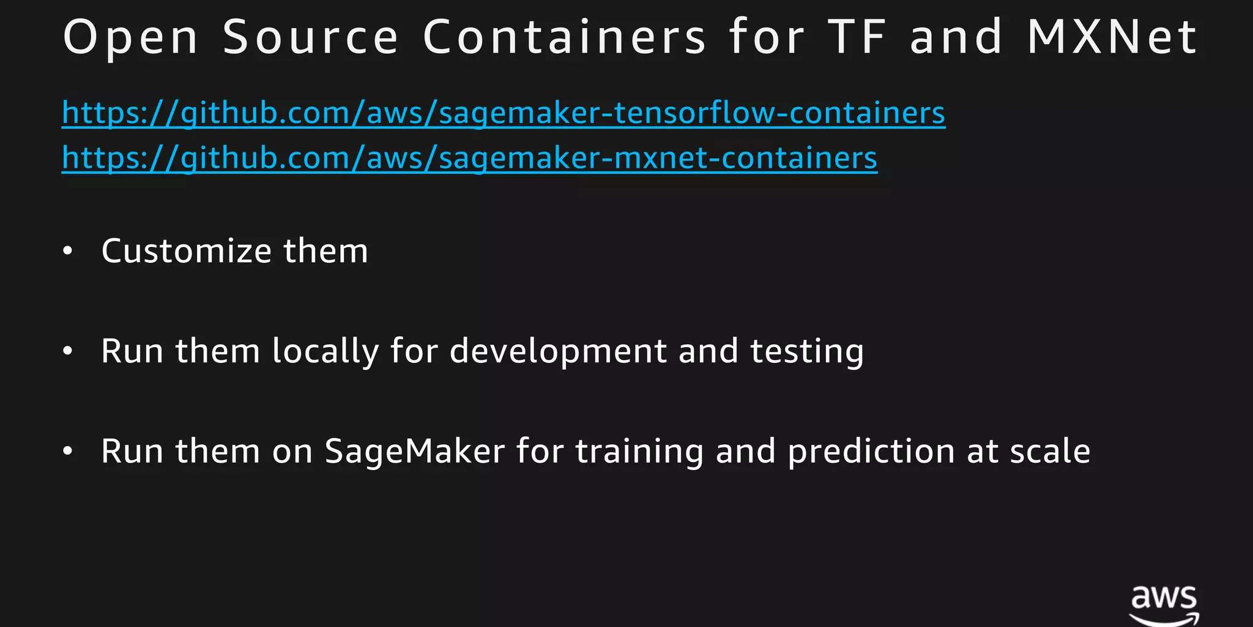
Sushant – 12218023

Slide 14
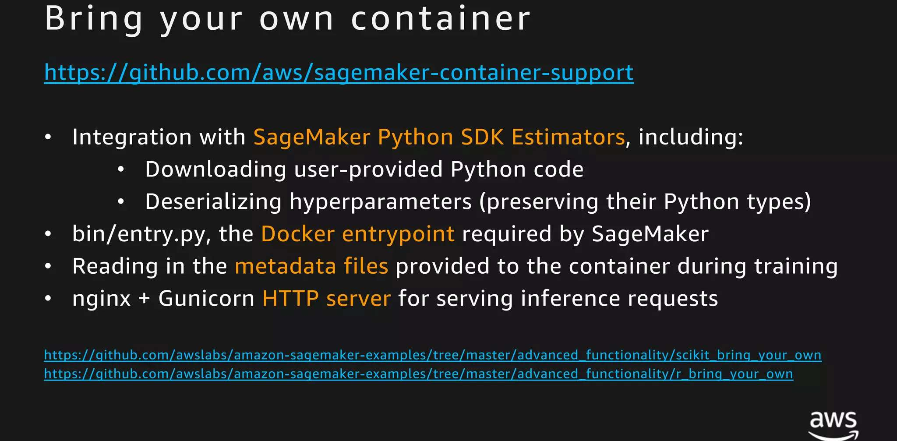
Sushant – 12218023

Slide 15
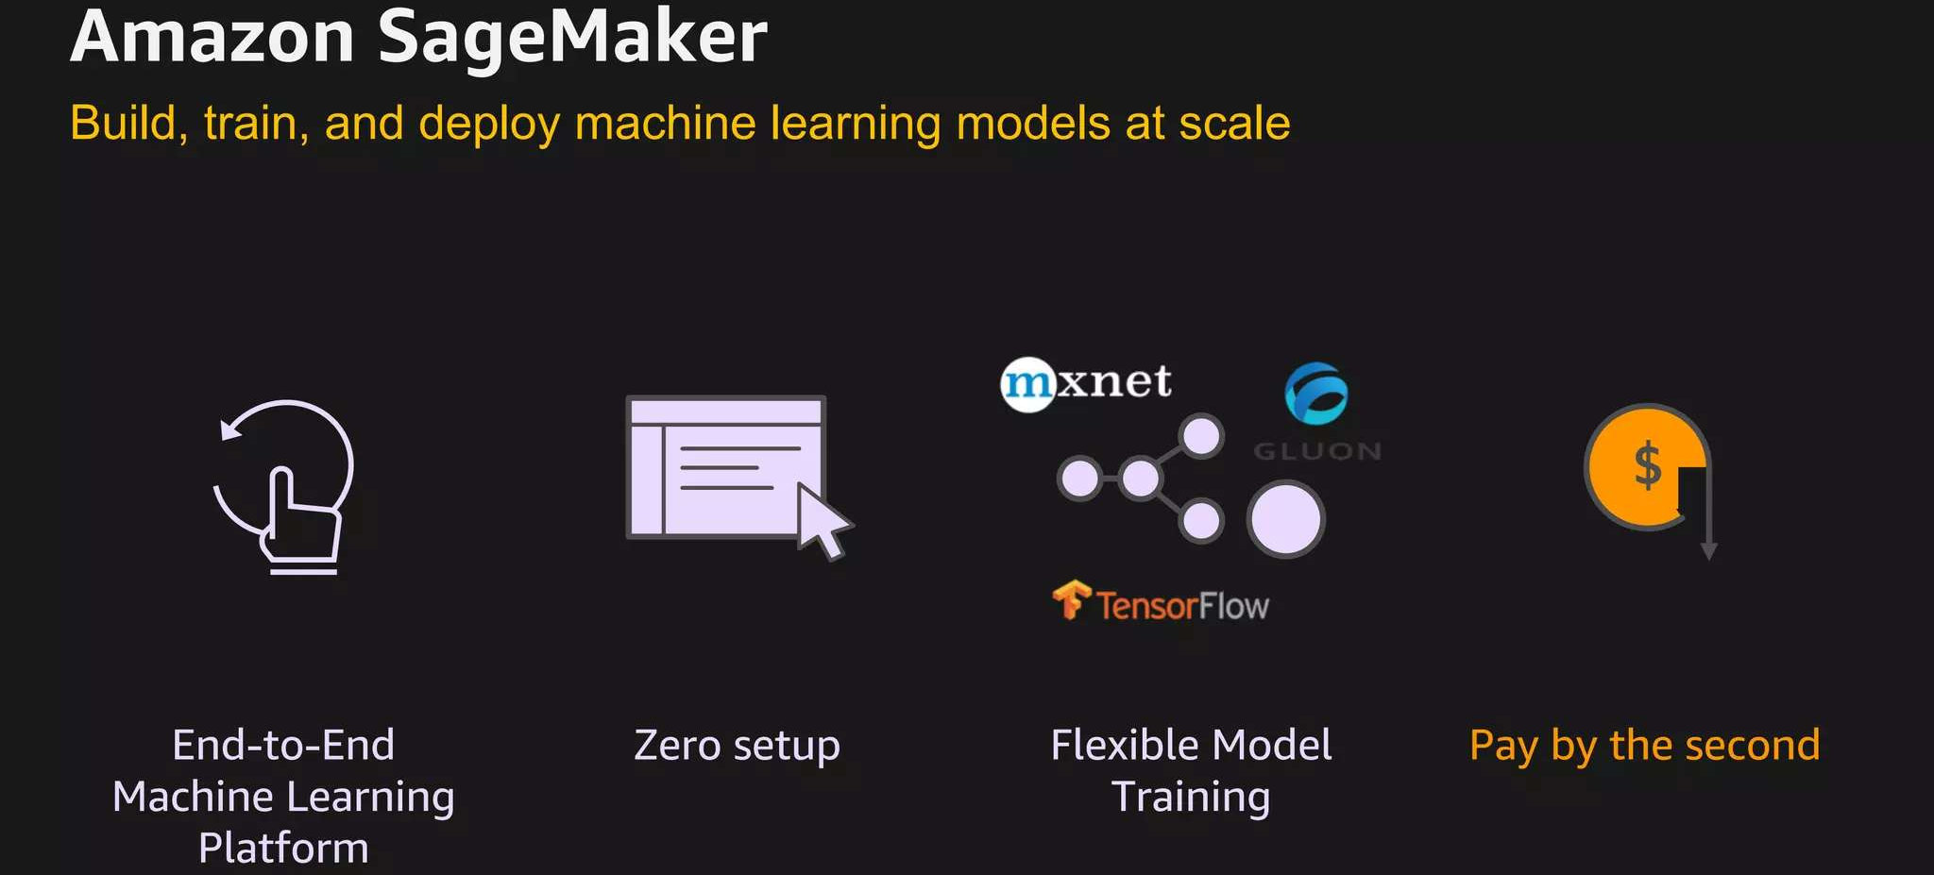
Sushant – 12218023

Slide 16
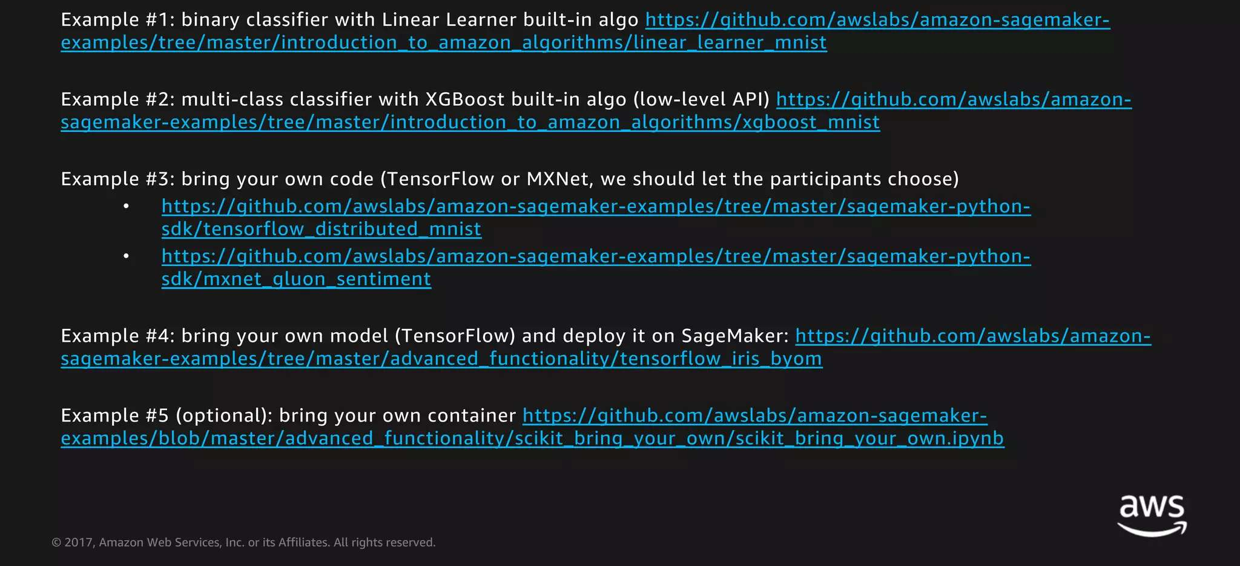
Sushant – 12218023

Slide 17
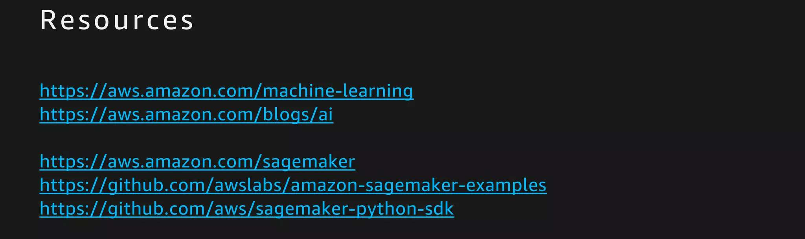
Sushant – 12218023

Slide 18

Thank You
Sushant – 12218023

